Slide 1
Digital Clock using Arduino Nano
And
16x2 LCD Display

Slide 2
Presented to:
Dr. Mosabber Uddin Ahmed
Professor(Part-Time)
Department of Electrical and Computer Engineering
North South University

Slide 3
Objective
The Digital Clock System project is to design a twelve-hour digital clock that displays the time digitally, in contrast to an analog clock, where the time is indicated by the positions of rotating hands. It is a relatively inexpensive craft and just a few materials are needed to complete it. This project's hardware component is relatively simple to construct. Digital clock is used into all kinds of devices such as cars, radios, televisions, microwave ovens, standard ovens, computers and cell phones.

Slide 4
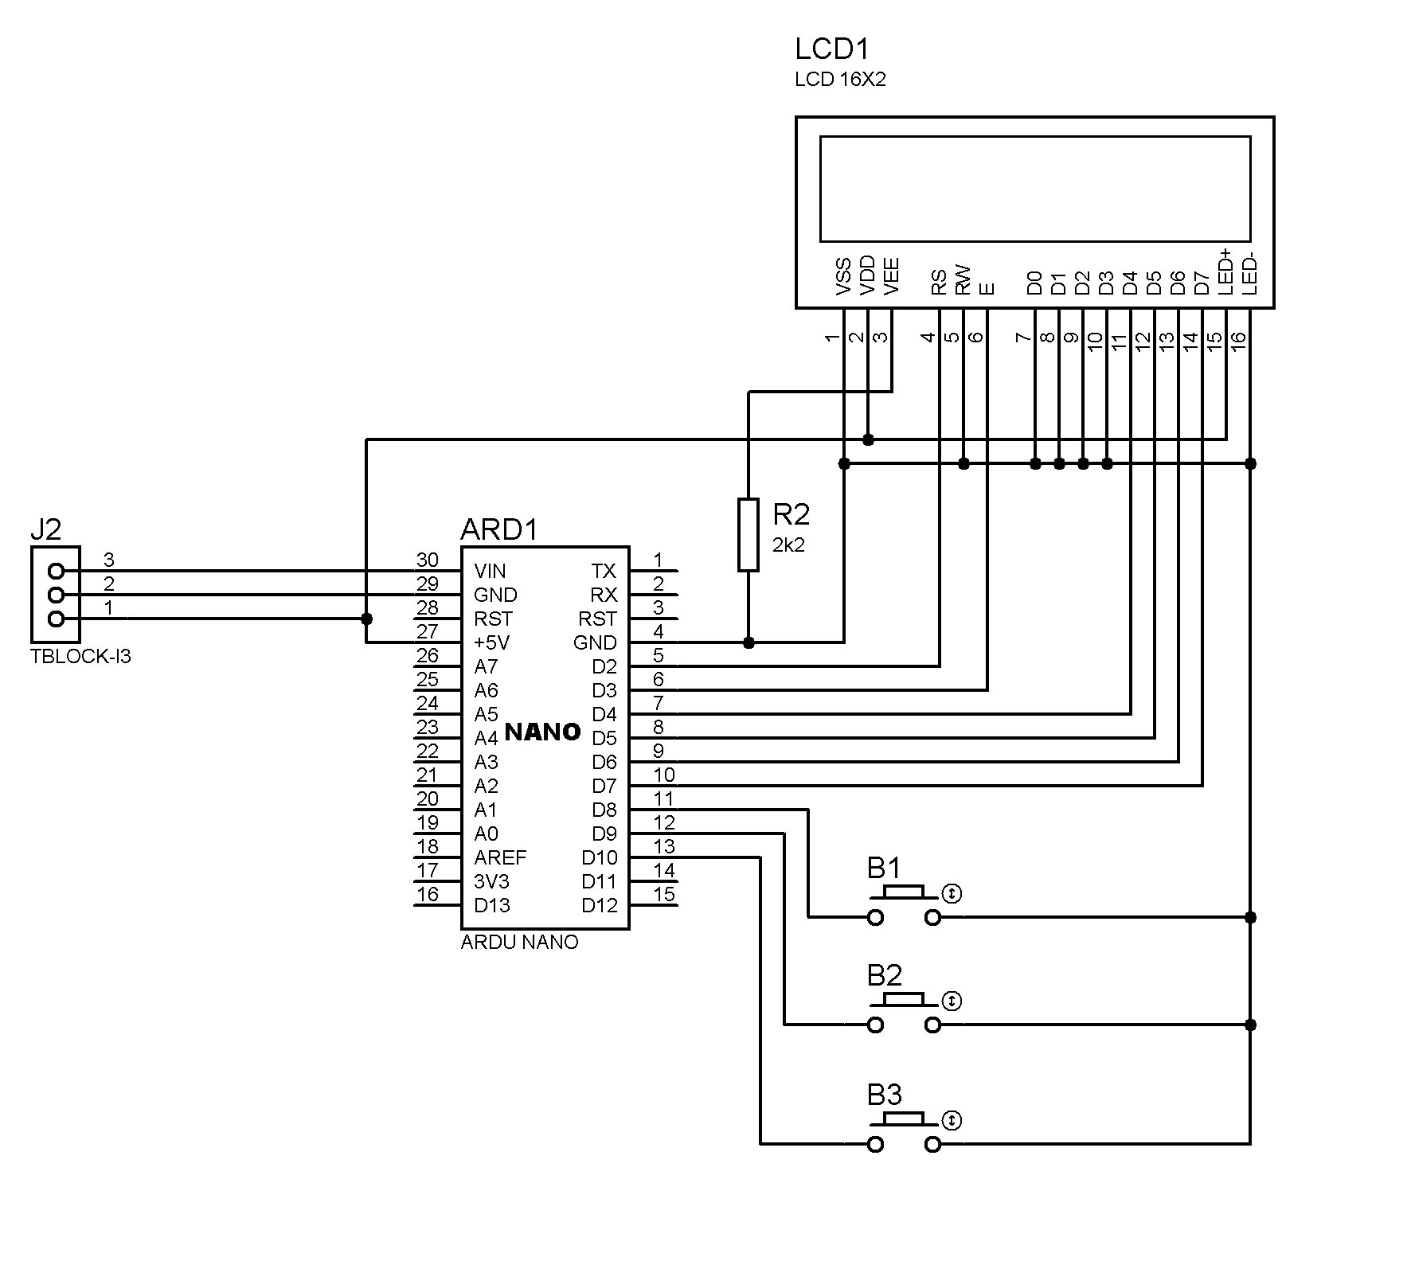
Ciccuit Diagram

Slide 5
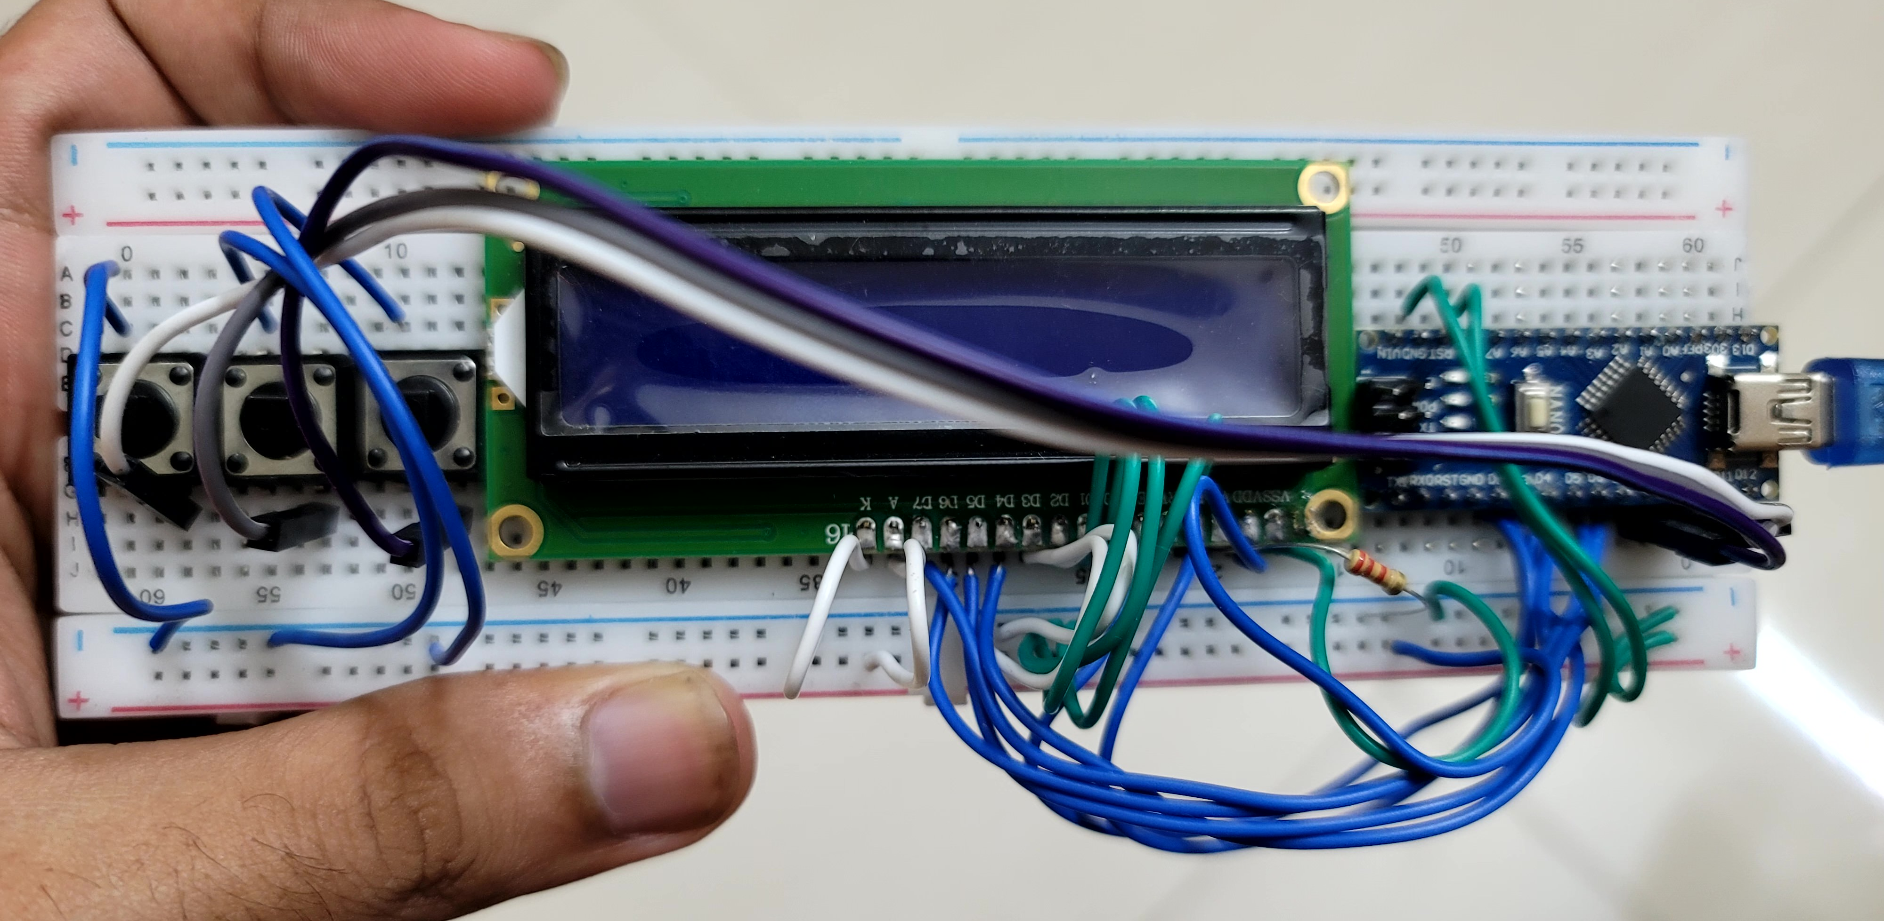
Circuit

Slide 6
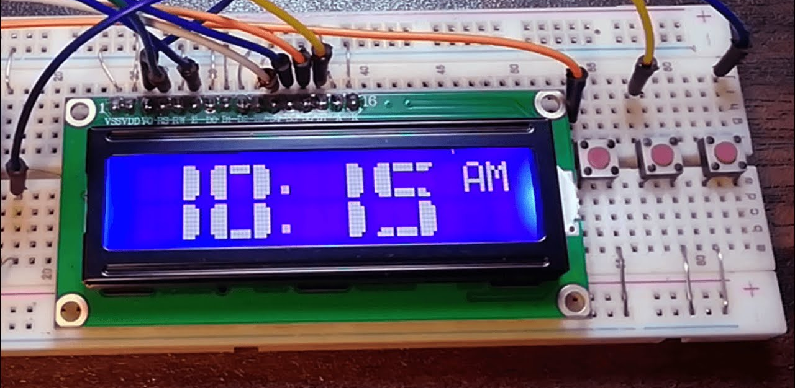
Simulation

Slide 7
Component Used:
Arduino Nano, Arduino IDE
16x2 LCD Screen
Push Buttons
Resistor
Bread Board
Jumper Wires

Slide 8
Procedures
First download Arduino IDE.
Will connect Arduino Nano and 16x2 LCD Display, Resistor and three push buttons via jumper wires.
Will do the code in IDE.
Will select board(Arduino Nano) and port(COM4/COM6).
Verify and upload the code.
After uploading is done, the output will be shown in the display.

Slide 9
Thank you.

